Slide 1
What Is XML?
eXtensible Markup Language for data
  Standard for publishing and interchange
  “Cleaner” SGML for the Internet
Applications:
  Data exchange over intranets, between companies
  E-business
  Native file formats (Word, SVG)
  Publishing of data
  Storage format for irregular data
  …

Slide 2
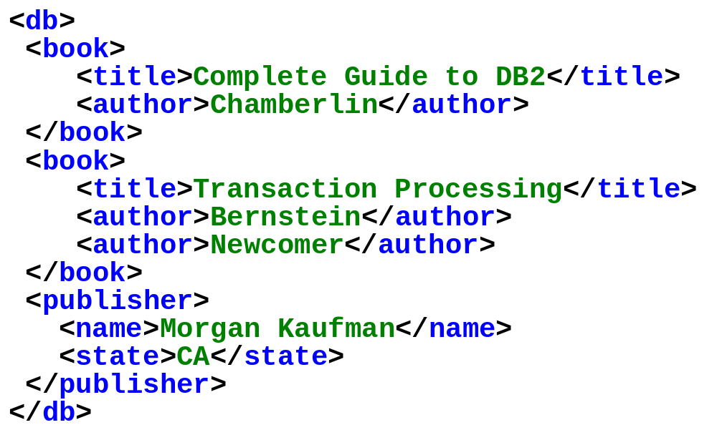
How Does it Look?
  Emerging format for data exchange on the web and between applications.

Slide 3
XML Terminology
tags: book, title, author, …
start tag: <book>, end tag: </book>
elements: <book>…<book>,<author>…</author>
elements are nested
empty element: <red></red> abbrv. <red/>
an XML document: single root element
well formed XML document: if it has matching tags

Slide 4
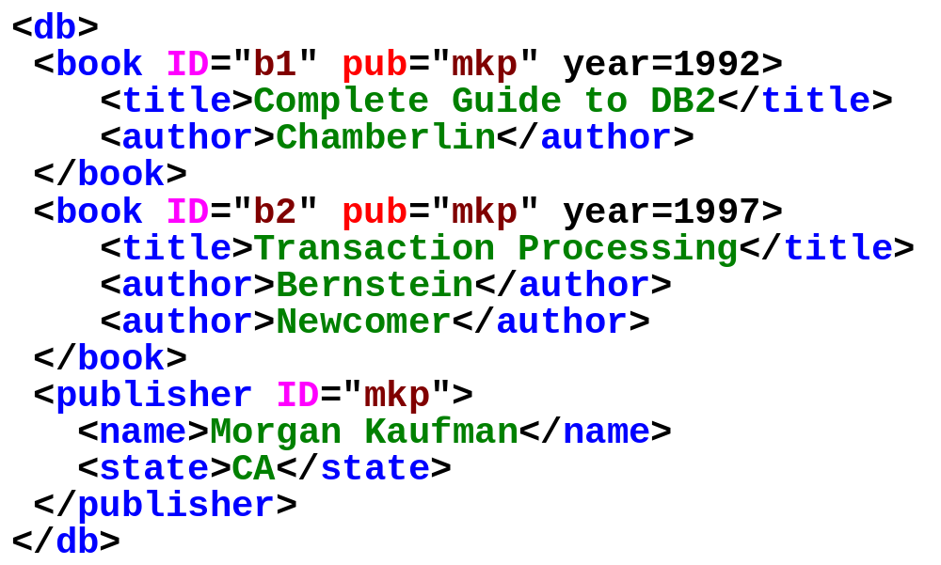
Attributes and References
XML distinguishes attributes from sub-elements.
ID’s and IDREFs are used to reference objects.
oids and references in XML are just syntax

Slide 5
What’s Special about XML?
Supported by almost everyone
Easy to parse (even with no info about the doc)
Can encode data with little or much structure
Supports data references inside & outside document
Presentation layer for publishing (XSL)
Human readable. No need for proprietary formats anymore.
Many, many tools

Slide 6
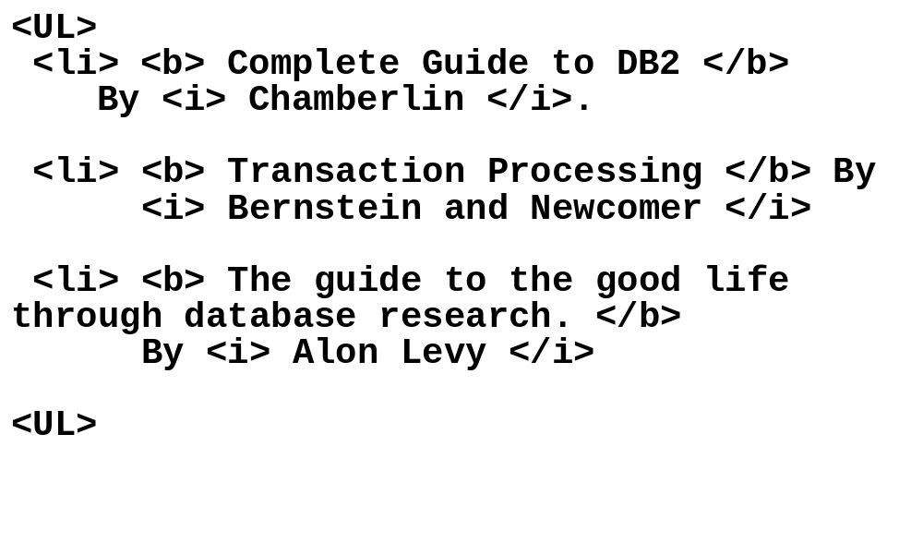
Origin of XML
Comes from SGML (very nasty language).
Principle: separate the data from the graphical presentation.

Slide 7
XML, After the roots
A format for sharing data.
Applications:
  EDI: electronic data exchange:
    Transactions between banks
    Producers and suppliers sharing product data (auctions)
    Extranets: building relationships between companies
    Scientists sharing data about experiments.
  Sharing data between different components of an application.
  Format for storing all data in Office 2000.
Basis for data sharing and integration.

Slide 8
Why are we DB’ers interested?
It’s data, stupid. That’s us.
Proof by Altavista:
  database+XML -- 40,000 pages.
Database issues:
  How are we going to model XML? (graphs).
  How are we going to query XML? (XML-QL)
  How are we going to store XML (in a relational database? object-oriented?)
  How are we going to process XML efficiently? (uh… well..., um..., ah..., get some good grad students!)

Slide 9
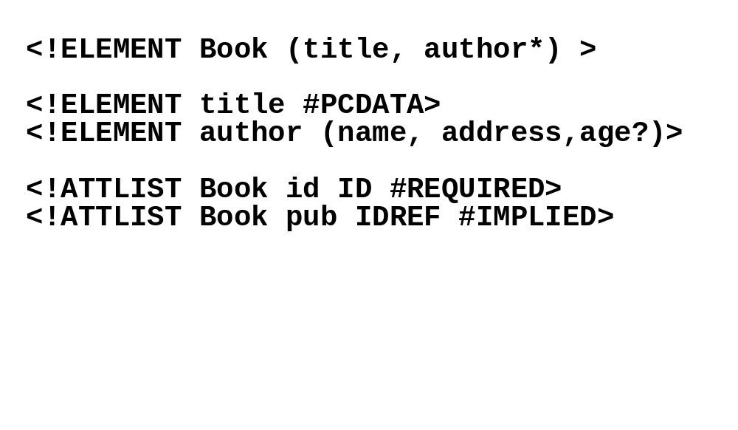
Document Type Descriptors
Sort of like a schema but not really.
Inherited from SGML DTD standard
BNF grammar establishing constraints on element structure and content
Definitions of entities

Slide 10
Shortcomings of DTDs
Useful for documents, but not so good for data:
No support for structural re-use
  Object-oriented-like structures aren’t supported
No support for data types
  Can’t do data validation
Can have a single key item (ID), but:
  No support for multi-attribute keys
  No support for foreign keys (references to other keys)
  No constraints on IDREFs (reference only a Section)

Slide 11
XML Schema
In XML format
Includes primitive data types (integers, strings, dates, etc.)
Supports value-based constraints (integers > 100)
User-definable structured types
Inheritance (extension or restriction)
Foreign keys
Element-type reference constraints

Slide 12
Sample XML Schema
<schema version=“1.0” xmlns=“http://www.w3.org/1999/XMLSchema”>
<element name=“author” type=“string” />
<element name=“date” type = “date” />
<element name=“abstract”>
<type>
…
</type>
</element>
<element name=“paper”>
<type>
<attribute name=“keywords” type=“string”/>
<element ref=“author” minOccurs=“0” maxOccurs=“*” />
<element ref=“date” />
<element ref=“abstract” minOccurs=“0” maxOccurs=“1” />
<element ref=“body” />
</type>
</element>
</schema>

Slide 13
Subtyping in XML Schema
<schema version=“1.0” xmlns=“http://www.w3.org/1999/XMLSchema”>
<type name=“person”>
<attribute name=“ssn”>
<element name=“title” minOccurs=“0” maxOccurs=“1” />
<element name=“surname” />
<element name=“forename” minOccurs=“0” maxOccurs=“*” />
</type>
<type name=“extended” source=“person” derivedBy=“extension”>
<element name=“generation” minOccurs=“0” />
</type>
<type name=“notitle” source=“person” derivedBy=“restriction”>
<element name=“title” maxOccurs=“0” />
</type>
<key name=“personKey”>
<selector>.//person[@ssn]</selector>
<field>@ssn</field>
</key>
</schema>

Slide 14
Important XML Standards
XSL/XSLT*: presentation and transformation standards
RDF: resource description framework (meta-info such as ratings, categorizations, etc.)
Xpath/Xpointer/Xlink*: standard for linking to documents and elements within
Namespaces: for resolving name clashes
DOM: Document Object Model for manipulating XML documents
SAX: Simple API for XML parsing
This weekend, somewhere in Germany, a W3C committee is meeting to discuss standard query language.

Slide 15
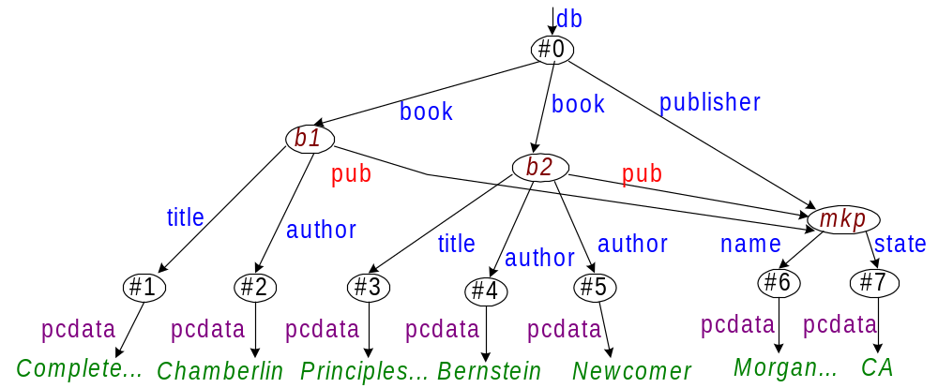
XML Data Model (Graph)
Think of the labels as
names of binary relations.
Issues:
distinguish between attributes and sub-elements?
Should we conserve order?

Slide 16
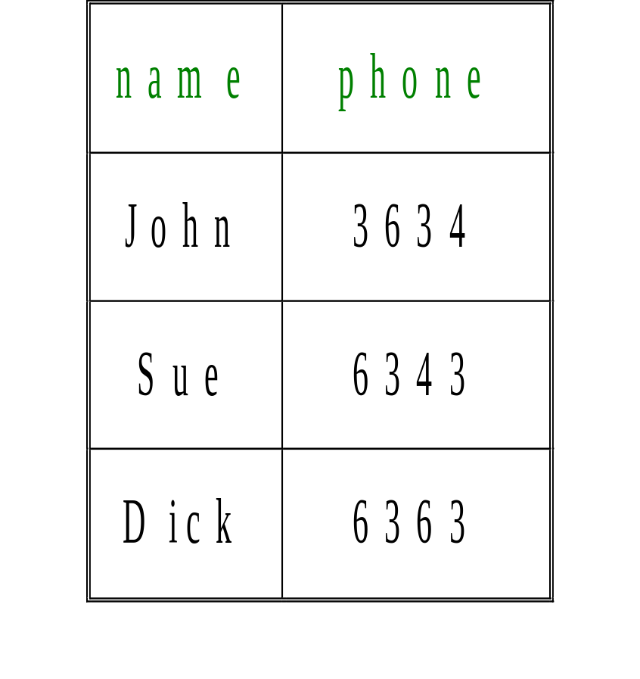
Comparison with Relational Data
row
row
row
name
phone
name
phone
name
phone
“John”
3634
“Sue”
6343
“Dick”
6363
No strict typing
Arbitrary nesting
Data can be irregular
Schema is part of the data

Slide 17
Querying XML
Requirements:
  Query a graph, not a relation.
  The result should be a graph (representing an XML document), not a relation.
  No schema.
  We may not know much about the data, so we need to navigate the XML.

Slide 18
Query Languages
First, there was XQL (from Microsoft).
Very quickly realized that it was very limited.
Then, a bunch of database researchers looked at XML and invented XML-QL.
  XML-QL comes from the nicer StruQL language.
  Many people got excited. Formed a committee.
Last week: Quilt, a new language combining the best of XML-QL and XQL. Stay tuned.

Slide 19
Extracting Data by Query
Matching data using elements patterns.
WHERE <book>
<publisher><name>Addison-Wesley</></>
<title> $t </>
<author> $a </>
</book> IN “www.a.b.c/bib.xml”
CONSTRUCT $a

Slide 20
Constructing XML Data
WHERE <book>
<publisher><name>Addison-Wesley</></>
<title> $t </>
<author> $a </>
</> IN “www.a.b.c/bib.xml
CONSTRUCT <result>
<author> $a </>
<title> $t</>
</>

Slide 21
Grouping with Nested Queries
WHERE <book>
<title> $t </>,
<publisher><name>Addison-Wesley</></>
</> CONTENT_AS $p IN “www.a.b.c/bib.xml”
CONSTRUCT <result>
<titre> $t </>
WHERE <author> $a </> IN $p
CONSTRUCT <auteur> $a</>
</>

Slide 22
Joining Elements by Value
WHERE
<article> <author> <firstname> $f </> <lastname> $l </>
</> </> ELEMENT_AS $e IN “www.a.b.c/bib.xml”
<book year=$y> <author>
<firstname> $f </> <lastname> $l </>
</> </> IN “www.a.b.c/bib.xml” , y > 1995
CONSTRUCT $e
Find all articles whose writers also published a book
after 1995.

Slide 23
Tag Variables
WHERE <article> <author>
<firstname> $f </> <lastname> $l </>
</> </> ELEMENT_AS $e IN “www.a.b.c/bib.xml”
<$t year=$y> <author>
<firstname> $f </> <lastname> $l </>
</> </> IN “www.a.b.c/bib.xml” , y > 1995
CONSTRUCT $e
Find all articles whose writers have done something
after 1995.

Slide 24
Regular Path Expressions
WHERE
<part*>
<name>$r</>
<brand>Ford</> </>
IN "www.a.b.c/bib.xml"
CONSTRUCT
<result>$r</>
Find all parts whose brand is Ford, no matter what level
they are in the hierarchy.

Slide 25
Regular Path Expressions
WHERE
<part+.(subpart|component.piece)>$r</>
IN "www.a.b.c/parts.xml"
CONSTRUCT
<result> $r </>

Slide 26
XML Data Integration
Query can access more than one XML document.
WHERE <person>
<name></> ELEMENT_AS $n
<ssn> $ssn </>
</> IN “www.a.b.c/data.xml”
<taxpayer>
<ssn> $ssn </>
<income></> ELEMENT_AS $I
</> IN “www.irs.gov/taxpayers.xml”
CONSTRUCT <result> $n $I </>

Slide 27
Skolem Functions in XML-QL
where <book language = $l>
<author> $a </>
</> in “www.a.b.c/bib.xml”
construct <result> <author id=F($a)> $a</>
<lang> $l </>
</>
<result> <author>Smith</author>
<lang>English</lang> <lang>Mandarin</lang>
</result>
<result> <author>Doe</author> <lang>English</lang> </result>

Slide 28
Query Processing For XML
Approach 1: store XML in a relational database. Translate an XML-QL query into a set of SQL queries.
  Leverage 20 years of research & development.
Approach 2: store XML in an object-oriented database system.
  OO model is closest to XML, but systems do not perform well and are not well accepted.
Approach 3: build an entire DBMS tailored to XML.
  Still in the research phase.

Slide 29
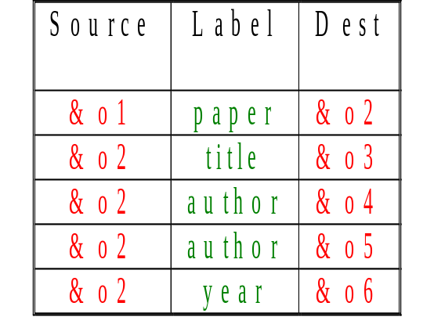
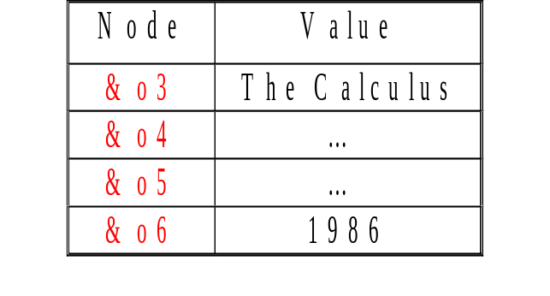
Store XML in Ternary Relation
Ref
&o1
paper
&o2
title
year
author
author
Val
&o3
&o4
&o5
&o6
“The Calculus”
“…”
“…”
“1986”
[Florescu, Kossman 1999]

Slide 30
Use DTD to derive Schema
DTD:
ODMG classes:
[Christophides et al. 1994 , Shanmugasundaram et al. 1999]
  <!ELEMENT employee (name, address, project*)>
  <!ELEMENT address (street, city, state, zip)>
  class Employee public type tuple
  (name:string, address:Address, project:List(Project))
  class Address public type tuple (street:string, …)

Slide 31
The Future
Many research problems remain:
  Efficient storage of XML
  How to leverage relational DBMS
  Update formalisms
  Processing streaming data
  Transactions
  Everything else we think about in databases.

